Slide 1
Personality
The word personality has been derived from the Latin word “personare”.It means to
speak through. It describes the person as a whole. It is the sum total of ways in which an
individual reacts and interacts with others.
In the opinion of Ruch, “personality can be described as how he understands and views
himself, and his pattern of inner and outer measurable traits.”

Slide 2
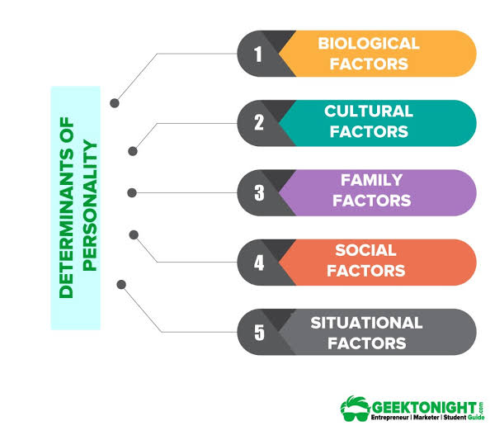
DETERMINANTS OF PERSONALITY

Slide 3
HEREDITY
The following characteristics are said to be inherited from their parent’s by all humans:
Physical structure
Reflexes
Innate drive
Intelligence
Temperament

Slide 4
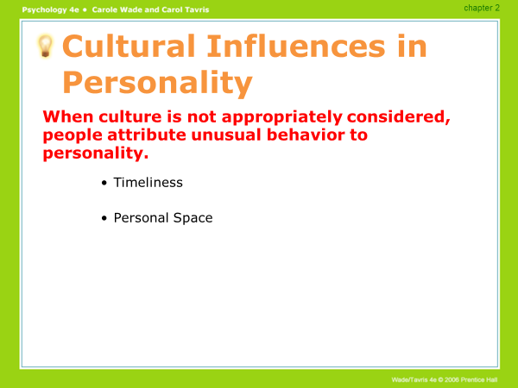
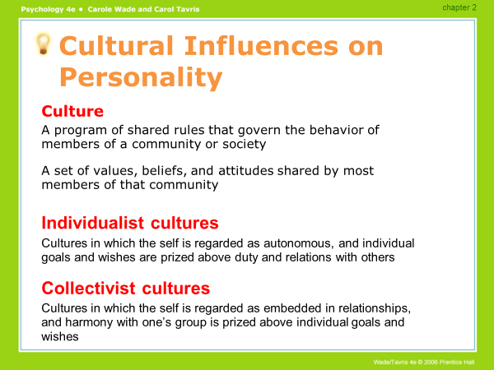
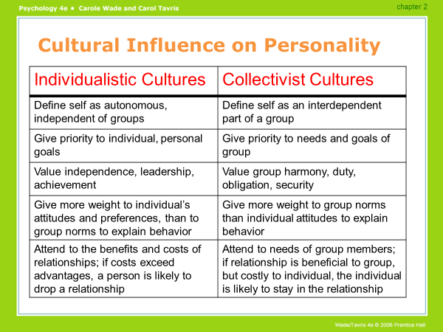

Slide 5
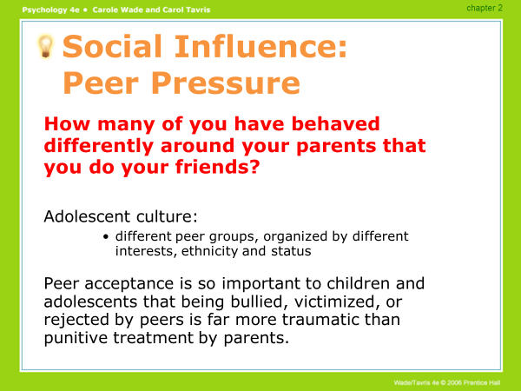

Slide 6
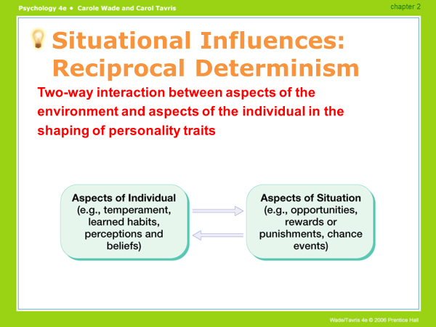

Slide 7


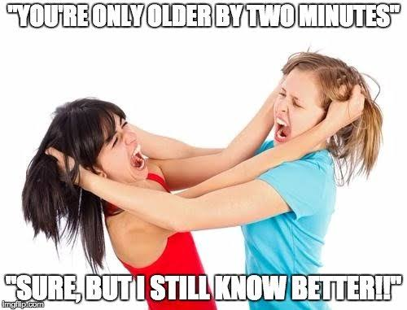





FAMILY
One of the very important determinants of the personality of a person is his/her immediate family.
Families influences the persons behavior of a person especially in the early stage.
The nature of such influence will depend upon the following factors:
Birth order
Parents Education
Socio-Economic level
Race
Religion
z
Family size

Slide 8
Theories of Personality
2
2
3
4
1
Psychoanalytic theory
Humanistic theory
Type Theory
Trait Theory

Slide 9
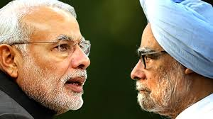
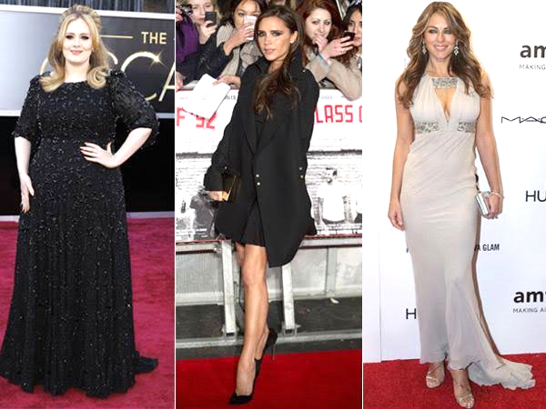
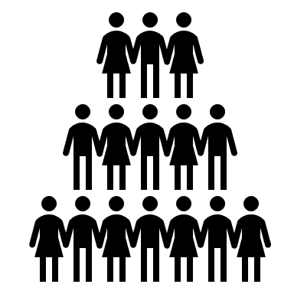
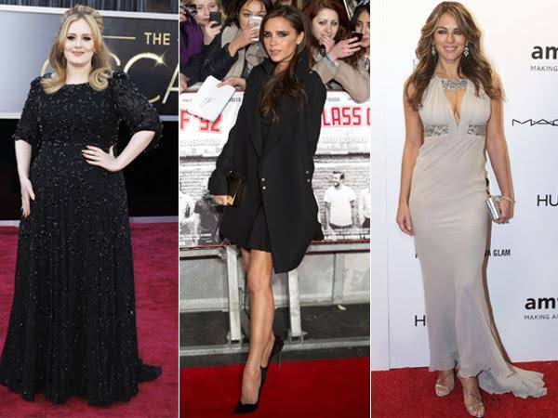
Type Theory
categorisation
Psychological factors
Physiological Factors

Slide 10


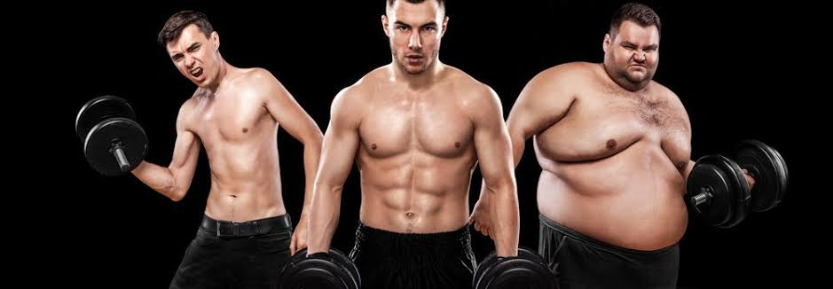
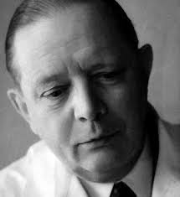
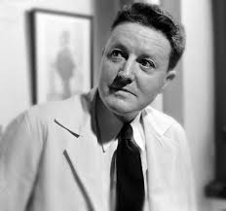
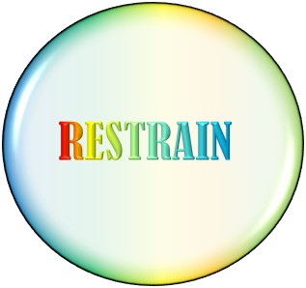
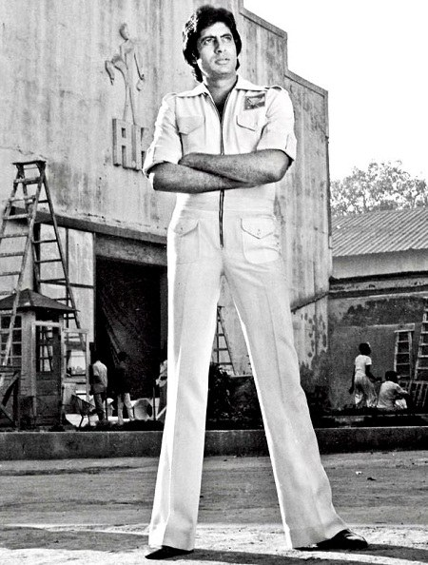
Physiological Factors
SHORT
sociable
Ihjbhi;qdsbqsdjds
2
1
ACTOMORPH
PULP
ACTOMORPH
relaxed
Even-tempered
NOISY & CALLOUS
TALL
2
ENDOMORPH
2
ENDOMORPH
FOND OF PHYSICAL ACTIVITY
SELF-CONSCIOUS
Kretschmar
Sheldon
Haevy-set
muscular
THIN
SOLITUDE
2
3
MESOMORPH
MESOMORPH

Slide 11
Type Theory
Psychological factors
Extrovert
Introvert
Gregarious
Sociable individual
Shy
Quiet
Retiring

Slide 12

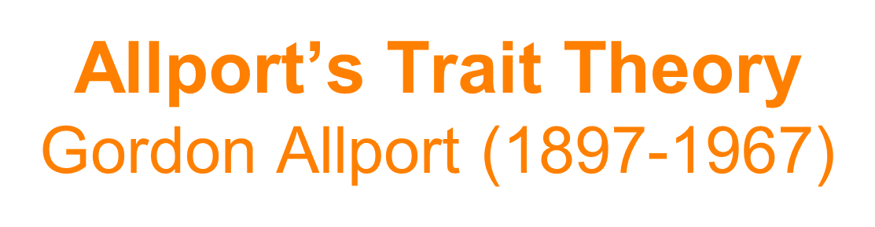
Cardinal Trait
Dominates and shapes personality, rare
Central Trait
Basic building blocks of personality that everyone has to some degree
Secondary Trait
Only seen in certain circumstances

Slide 13
Big Five
Personality
Traits
E
C
A
O
N

Slide 14
o
Openness to Experience
Open = Curiosity, imaginative, creative
Resistant = Conforming, predictable

Slide 15
Conscientiousness
C
Conscientious = Responsible, persevering, self-disciplined
Impulsive = Quick to give up, fickle, careless

Slide 16
Extroversion
E
Extroversion = Outgoing – talkative, sociable, adventurous
Introversion = Shy – silent, reclusive, cautious

Slide 17
Agreeableness
Agreeable = Good-natured, cooperative, secure
Antagonistic = Irritable, abrasive, suspicious, jealous
A

Slide 18
Neuroticism
Neurotic = anxious, impulsive, worrier, emotionally negative
Emotionally stable = only has those feelings when the circumstances dictate
N

Slide 19


Sigmund Freud – psychoanalysis
Explains behavior and personality in terms of unconscious dynamics within the individual
Emphasizes internal conflicts, attachments, and motivations
Adult personalities are formed by experiences in early childhood
Three variations:
Freud and traditional psychoanalysis
Jungian Theory
Object-Relations School

Slide 20
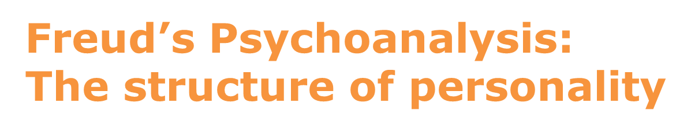
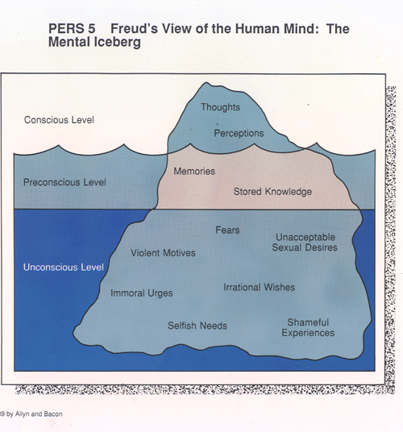
Id
- Unconscious
Ego
- unconscious, preconscious,
conscious
Superego
- unconscious, preconscious, conscious

Slide 21
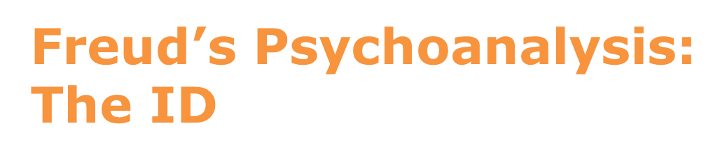
Freud’s Psychoanalysis: The Superego
Freud’s Psychoanalysis: The Ego
Operates according to the pleasure principle
Present from birth
Primitive
basic needs and wants
2 competing instincts:
Life (sexual) - libido
Death (aggressive)
Unconscious
Operates according to the reality principle
Arises in first 3 years of life
Mediates between ID and Superego
Rational part of mind
you can’t always get what you want
Floats between all 3 levels of consciousness
Moral Conscience
Develops around age 5
At end of Phallic Stage
Stores and enforces rules
Inner voice that tells you not to do something or that what you did was wrong
2 subsystems:
Ego Ideal = parents approve/value
Conscience = parents disapproval

Slide 22


Humanistic Approaches to Personality
Humanistic psychology
An approach that emphasizes personal growth, resilience, and the achievement of human potential
Humanist psychologists:
Abraham Maslow
Carl Rogers
Rollo May

Slide 23
Humanistic Psychology: Carl Rogers
Interested in fully functioning individuals
Congruence
this is displayed by fully functioning people and is a harmony between the image they project to others and their true feelings or wishes
To become fully functioning we need:
Unconditional positive regard
A situation in which the acceptance and love one receives from significant others is unqualified, no strings attached
Unfortunately many children and adults are treated with:
Conditional positive regard
A situation in which the acceptance and love one receives from significant others is contingent upon one’s behavior

Slide 24
Major Personality Traits Influencing OB
Authoritarianism
Machiavellianism
Problem solving styles
Achievement Orientation
Locus of Control
Self esteem
Self Monitoring
Risk Taking
Type A and Type B personality

Slide 25
Major Personality Traits Influencing OB
Authoritarianism
Machiavellianism
Problem solving styles
People who are likely to have authoritarian orientation tend to use their power more
aggressively towards their subordinates and create a very defensive climate in the department,
while at the same time they are being very submissive or docile towards their supervisors.
Dogmatism refers to the extent to which people are flexible or rigid in dealing others. Managers
who are exhibiting these traits are likely to be detached from others and people show much of
hatred ness in them.
Achievement Orientation
Locus of Control
Self esteem
Self Monitoring
Risk Taking
Type A and Type B personality

Slide 26
Major Personality Traits Influencing OB
Authoritarianism
Machiavellianism
This refers to the extent to which people are manipulative and tactic in achieving one’s
own goals. These people strongly believe that ends can justify means. People who are high
Machiavellian tend to be cool, willing to twist and turn facts to influence others and try to gain control of people, events, and situations by manipulating the system to their advantage. High Machiavellians may be successful only for a short period but in long run they tend to be
distrusted and disliked by many in the department and finally they may be ineffective.
High-Machiavellians manipulates more, win more, are persuaded less and have a grater
influence over other people than do low-Machiavellians. Yet these High-Machiavellians
outcomes are moderated by situational factors. It has been found that High- Machiavellians
flourish:
when they interact face-to-face with others rather than indirectly
when the situation has a minimum number of rules and regulations, thus allowing latitude for improvisation where emotional involvement with details irrelevant to winning distracts low Machiavelli
Problem solving styles
Achievement Orientation
Locus of Control
Self esteem
Self Monitoring
Risk Taking
Type A and Type B personality

Slide 27
Major Personality Traits Influencing OB
Authoritarianism
Problem solving styles
Machiavellianism
Individuals have their own style of solving their problems and make their decisions and this style of their affects their personality in certain ways.
There are four problem solving styles
Achievement Orientation
Locus of Control
Sensation Feeling Style
Sensation Thinking Style
Intuition Feeling Style
Intuition Thinking Style
Self esteem
Self Monitoring
Risk Taking
Type A and Type B personality

Slide 28
Major Personality Traits Influencing OB
Authoritarianism
Achievement Orientation
Machiavellianism
Achievement Orientation or a high need to achieve is a personality trait which varies among different types of people and can be used to predict certain behaviour.
The people with very high achievement Orientation strive to do things in a better way. They want to feel that their success or their own action. These people do not like to perform easy task where there is no challenges or tasks with very high risk as the failure rate is more.
Problem solving styles
Locus of Control
Self esteem
Self Monitoring
Risk Taking
Type A and Type B personality

Slide 29
Major Personality Traits Influencing OB
Authoritarianism
Locus of Control
Machiavellianism
It refers to the extent to which people tend to have control over their own fate and life. There are two type of locus of control. The Internal Locus of Control refers to those who believe that they control what happens to them and shape the course of their evens in their lives, whereas the External Locus of Control believe that what happens to them is controlled by outside forces such as luck or chance. Internals always believe in putting more effort and seek more job related information, rely more on their own abilities and judgment at work, and more actively seek opportunities for advancement
Problem solving styles
Achievement Orientation
Self esteem
Self Monitoring
Risk Taking
Type A and Type B personality

Slide 30
Major Personality Traits Influencing OB
Authoritarianism
Self esteem
Machiavellianism
It refers to the individuals’ self worthiness and the extent to which they regard themselves as capable, successful, important and worthwhile. People who feel good about themselves will always produce good results. Studies of self-esteem show that it is closely related to mental health. People with low self-esteem are more likely to suffer depression and greater stress. People with positive self-esteem adjust to life better and deal everyday problems more effectively. Individuals’ with high self-esteem will try to take up more challenging assignments and be successful, which in turn, enhance their overall self-concept. People with high self esteem would tend to classify themselves as highly valuable in the organization.
Problem solving styles
Achievement Orientation
Locus of Control
Self Monitoring
Risk Taking
Type A and Type B personality

Slide 31
Major Personality Traits Influencing OB
Authoritarianism
Self Monitoring
Machiavellianism
It refers to the extent to which a person has the ability to adjust his or her behavior to external or situational factors. Those with high self-monitoring will be more sensitive and notice the significant changes occurring in the environment and able to adapt them by adjusting their behavior. High self-monitors are capable of exhibiting a striking contrast between their public persona and their private self. Low self-monitors cannot disguise their behavior and tend to exhibit the same behavior all the time.
Problem solving styles
Achievement Orientation
Locus of Control
Self esteem
Risk Taking
Type A and Type B personality

Slide 32
Major Personality Traits Influencing OB
Authoritarianism
Risk Taking
Machiavellianism
This refers to the extent to which people are willing to take chances. This propensity to assume or to avoid risk has been shown to have an effect on their decision making capabilities and information gathering process. High risk taking managers made more rapid decision and used less information in making their choices than did the low risk taking managers.
The requirement of Risk taking propensity varies from the different types of job
demands. For instance, a high risk taking propensity may lead to more effective performance for a stockbroker in brokerage firm than an accountant whose job demands more cautious approach in dealing each and every one of the things. An accountant performing auditing activities is expected to have low-risk taking propensity as his nature of job demands to follow a book of rules and regulation
Problem solving styles
Achievement Orientation
Locus of Control
Self esteem
Self Monitoring
Type A and Type B personality

Slide 33
Major Personality Traits Influencing OB
Authoritarianism
Type A and Type B personality
Machiavellianism
This refers to the extent to which people tend exhibit certain characteristics. Type A person feels a chronic sense of time urgency, are highly achievement oriented, exhibit a competitive drive and are impatient when their work is slowed down for any reason. Type B persons are easygoing individuals who do not have sense of time urgency, and who do not experience the competitive drive
Problem solving styles
Achievement Orientation
Locus of Control
Competitive
High Need for Achievement
Aggressive
Works Fast
Impatient
Restless
Extremely Alert
Tense Facial Muscles
Able to Take Time to Enjoy Leisure
Not Preoccupied with Achievement
Easy Going Works at Steady Pace
Seldom Impatient
Relaxed
Not Easily Frustrated
Moves Slowly
Seldom
Self esteem
A
B
Self Monitoring
Risk Taking

Slide 34
Role of Personality in Organizational Behavior
Personality plays a key role in organizational behavior because the way that people think, feel, and behave affects many aspects of the workplace. People's personalities influence their behavior in groups, their attitudes, and the way they make decisions. Interpersonal skills hugely affect the way that people act and react to things during work. In the workplace, personality also affects such things as motivation, leadership, performance, and conflict. The more that managers understand how personality in organizational behavior works, the better equipped they are to be effective and accomplish their goals. People have many different views of the world that affect their personalities. When a situation arises, an individual will handle it based upon his or her personal values, beliefs, and personality traits. These traits are developed throughout a person's lifetime and cannot be easily changed, so it is more helpful for managers to attempt to understand this rather than to fight it. Traits such as openness, emotional stability, and agreeableness all predict that an individual will have less conflict, work better in teams, and have positive attitudes about his or her work. People with this type of personality should be placed in situations where they would be working with or leading others. Those who do not have these traits will have less motivation and be more negative when they are placed in these same situations. Positive interpersonal skills is a personality trait that greatly affects the workplace. Individuals who exhibit this trait generally enjoy working with other people, and they have the empathy and sensitivity that enables them to get along well with others. People with this trait are often placed in roles where they work with customers, manage employees, or mediate problems. Decision-making and independence are greatly affected by personality. Personality traits such as self-efficacy, conscientiousness, and pro-activity contribute to good decision-making under pressure and independence, while traits such as neuroticism and not being open do not. Managers can place individuals with these traits in appropriate positions to do their best work. Placing individuals with certain characteristics in jobs that best suit them raises their levels of motivation. It also affects their overall job performance because they are happier on a daily basis. This affects the overall productivity of the workplace because more is getting accomplished due to better attitudes and happier employees.

Slide 35
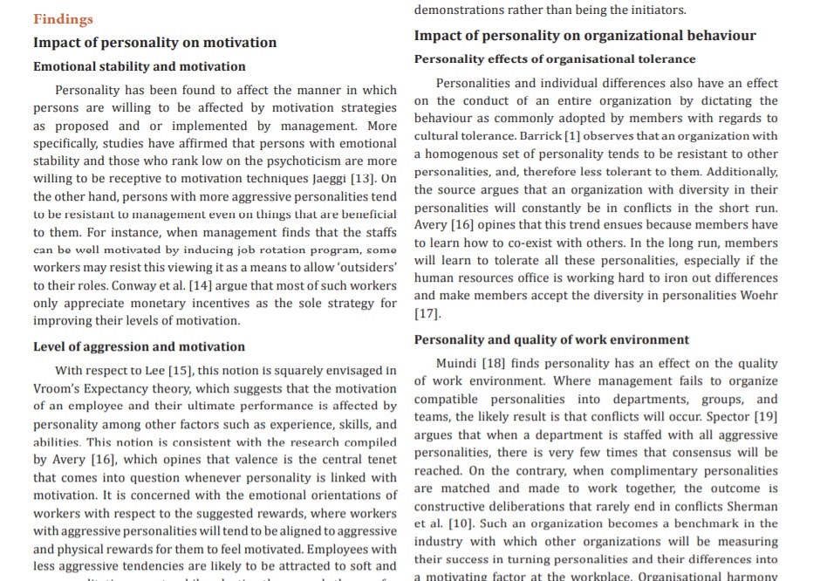
Role of Personality in Organizational Behavior
Personality plays a key role in organizational behavior because the way that people think, feel, and behave affects many aspects of the workplace. People's personalities influence their behavior in groups, their attitudes, and the way they make decisions. Interpersonal skills hugely affect the way that people act and react to things during work. In the workplace, personality also affects such things as motivation, leadership, performance, and conflict. The more that managers understand how personality in organizational behavior works, the better equipped they are to be effective and accomplish their goals. People have many different views of the world that affect their personalities. When a situation arises, an individual will handle it based upon his or her personal values, beliefs, and personality traits. These traits are developed throughout a person's lifetime and cannot be easily changed, so it is more helpful for managers to attempt to understand this rather than to fight it. Traits such as openness, emotional stability, and agreeableness all predict that an individual will have less conflict, work better in teams, and have positive attitudes about his or her work. People with this type of personality should be placed in situations where they would be working with or leading others. Those who do not have these traits will have less motivation and be more negative when they are placed in these same situations. Positive interpersonal skills is a personality trait that greatly affects the workplace. Individuals who exhibit this trait generally enjoy working with other people, and they have the empathy and sensitivity that enables them to get along well with others. People with this trait are often placed in roles where they work with customers, manage employees, or mediate problems. Decision-making and independence are greatly affected by personality. Personality traits such as self-efficacy, conscientiousness, and pro-activity contribute to good decision-making under pressure and independence, while traits such as neuroticism and not being open do not. Managers can place individuals with these traits in appropriate positions to do their best work. Placing individuals with certain characteristics in jobs that best suit them raises their levels of motivation. It also affects their overall job performance because they are happier on a daily basis. This affects the overall productivity of the workplace because more is getting accomplished due to better attitudes and happier employees.

